Slide 1
Methods & Statistics in IO Psychology
Chapter 2

Slide 2
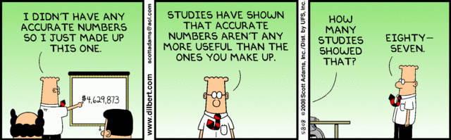
Overview
Module 2.1 – What is Science?
Module 2.2 – Research Design
Module 2.3 – Data Analysis
Module 2.4 – Interpretation

Slide 3
Module 2.1 – What is Science?

Slide 4
What is Science?
Approach that involves the understanding, prediction, and control of some phenomenon of interest
A set of methods used to
Collect information about phenomena in an area
Build a reliable base of information in an area
Develop theories to explain phenomena

Slide 5
Overview of Research in IO
Three purposes…
description
explanation- ex why stress = lower productivity
prediction – understand when its going to change and predict what will happen
…all rooted in Theory…
…confirmed and built upon by Data

Slide 6
Overview of Research in IO
The cycle of research
Theory
Data

Slide 7
The Scientific Method: Four Steps
Observing a Phenomenon
While observing a phenomenon, you identify the variables that appear important in explaining behavior
Formulating Tentative Explanations
Initial observations allow you to develop a hypothesis, or tentative statement, about the relationships among the variables identified

Slide 8
The Scientific Method: Four Steps
Further Observing and Experimenting
You carry out more detailed Observation of the behavior of interest
Refining and Retesting Explanations
Supported hypotheses are often refined and subjected to further exploration
Disconfirmed hypotheses may be reworked and retested

Slide 9
The Research Process
The cycle of research
Define Question
Develop Theory
Hypothesize
Collect Data
Publish Results
Interpret Data
Analyze Data

Slide 10
Vocab
Science – approach that involves the understanding, prediction, and control of some phenomenon of interest
Hypothesis – prediction about relationships among variables of interest
Disinterestedness – characteristics of scientists who should be objective and uninfluenced by biases or prejudice when conducting research
Expert Witness – witness in a lawsuit who is permitted to voice opinions about the organizational practices

Slide 11
Module 2.2 – Research Design

Slide 12
Research Design
Experimental Design
Random assignment of participants to conditions
Between-subjects, within-subjects, or single subject designs
Can be conducted in lab or field setting
Quasi-Experimental Design
Nonrandom assignment of participants to conditions
Quasi-independent variable (e.g., gender)
Can be conducted in lab or field setting

Slide 13
Research Design Continued
Nonexperimental Design
No unique conditions for participants
Observational or correlational designs
Generally conducted in the field

Slide 14
Research Design Continued
 | Laboratory Experiment | Quasi-Experiment | Questionnaire | Observation
Control (potential for testing causal relationships) | High | Moderate | Low | Low
Realism (naturalness of setting) | Low | High | Moderate | High

Slide 15
Methods of Data Collection
Quantitative
Rely on tests, rating scales, questionnaires, and physiological measures
Yield numerical results
Qualitative
Include procedures like observation, interview, case study, & analysis of written documents
Generally produce flow diagrams & narrative descriptions of events/processes
Can be converted to numerical results

Slide 16
Methods of Data Collection Continued
Quantitative vs. Qualitative – not mutually exclusive
Introspection – early scientific method in which the participants was also the experimenter, recording their experience in completing an experimental task (considered very subjective by modern standards)
Triangulation…
Data provided from multiple sources
Use of quantitative and qualitative data

Slide 17
Generalizability & Control
Generalize – to apply the results from one study or sample to other participants or situations
Called external validity
Every time a compromise is made, the generalizability of results is reduced
Population: the entire set of people or objects we want to study and to which we wish to generalize the findings
Sample: subgroup of the population that is used to infer about the characteristics of the population

Slide 18
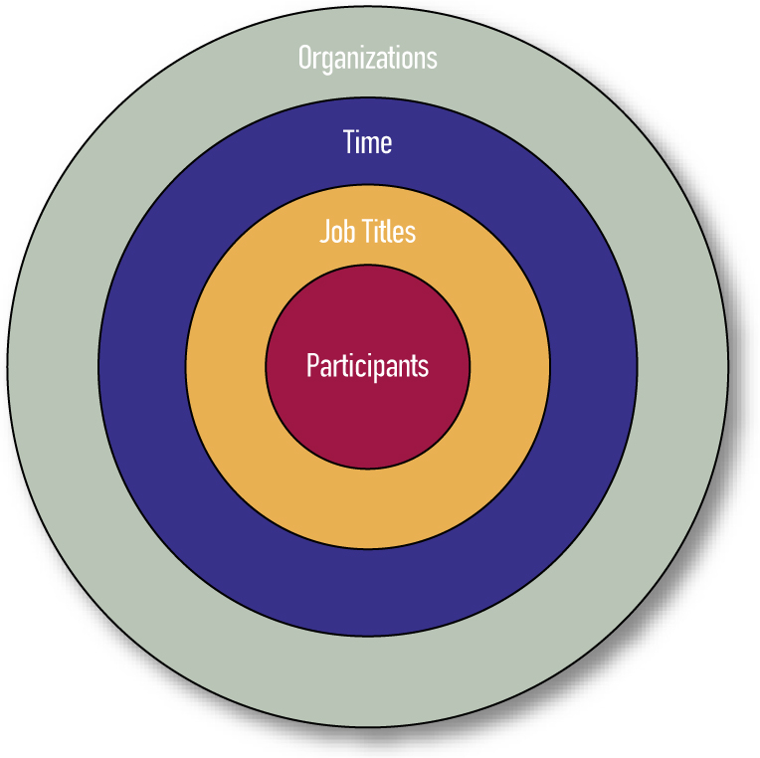
Sampling Domains for I-O Research
Figure 2.1: Sampling Domains
for I-O Research

Slide 19
Generalizability & Control
Experimental Control: research design eliminates influences that could make results less reliable or harder to interpret
Statistical Control: statistical techniques used to control for the influence of certain variables
Experimental control trumps statistical control

Slide 20
Ethical Behavior in I-O Psychology
Ethical standards of the APA
SIOP book of 61 cases (Lowman, 1998)
Cases illustrate ethical issues that are likely to arise in I-O psychology
Joel Lefkowitz (2003) published a book on values and ethics in I-O psychology

Slide 21
Module 2.3 – Data Analysis

Slide 22
Data Analysis
Descriptive Statistics
Summarize, organize, “describe” sample of data
Frequency Distribution:
Horizontal axis = Scores running low to high
Vertical axis = Indicates frequency of occurrence

Slide 23
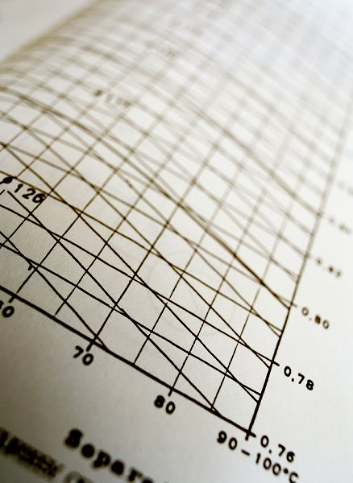
Measures of Central Tendency
Mode (most common score)
1 2 6 6 7 9 11 – mode = 6
Mean (the average)
1 2 3 4 5 6 – mean = 3.5
1 2 3 4 5 2000 – mean = 335.83
Median (the midpoint)
1 2 4 6 7 9 11 – median = 6
1 2 6 7 9 11 – median = 6.5
1 2 3 4 5 2000 – median = 3.5
Ryan McVay/Getty Images

Slide 24
Measures of Variability & Skew
Standard deviation
Describes the dispersion of data on either side of a mean value
The typical amount that each score varies, or “deviates”, from the mean
Lopsidedness or skew

Slide 25
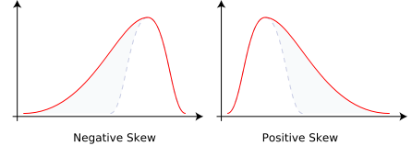
Skewness
Negative Skew – tail goes toward negative number
Positive Skew – tail goes toward positive numbers

Slide 26
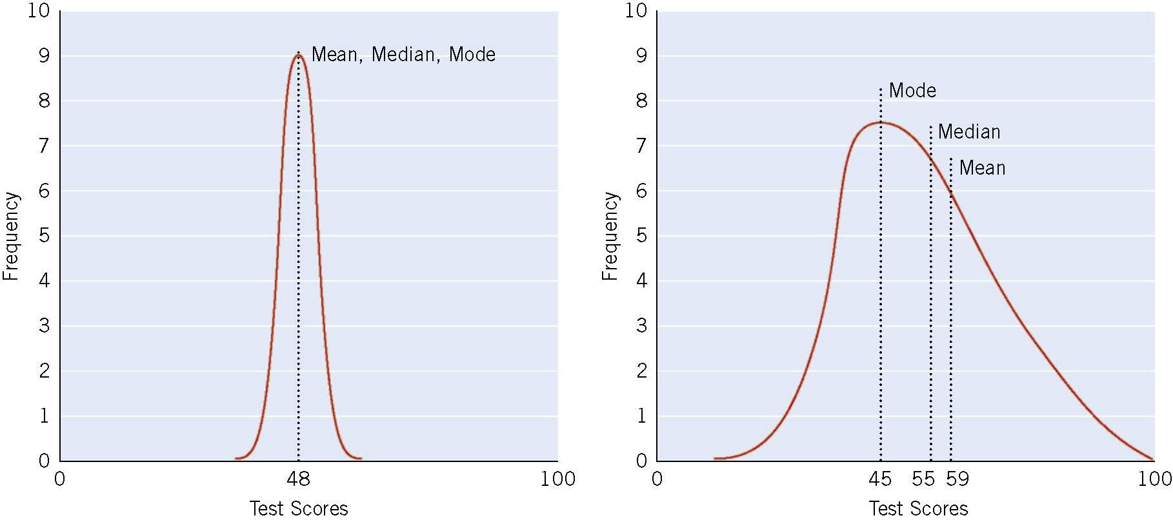
Descriptive Statistics: Two Score Distributions (N = 30)
Do not want to skinny or too wide – shows data is not good
Figure 2.2 Two Score Distribution (N=30)

Slide 27
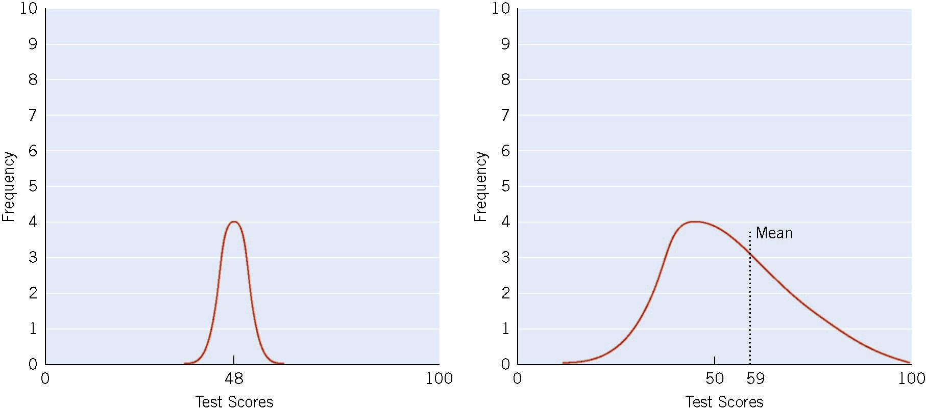
Two Score Distributions (N = 10)
Do not want too few test subjects.
Figure 2.3

Slide 28
Inferential Statistics
Aid in testing hypotheses & making inferences from sample data to a larger sample/population
Hypotheses – specific and directional (either positive and positive or negative and negative) – used to draw inferences from our sample to population
Examples include t-test, F-test, chi-square test

Slide 29
Statistical Significance
Defined in terms of a probability statement
Hypotheses testing find out whether we can reject of keep our hypotheses
Threshold for significance is often set at .05 or lower
Finding significant at the 5% level
i.e., a difference that large would be expected to occur only 5 times out of 100 as a result of chance alone
If test statistic is over .05 then fail to reject null hypotheses if lower then .05 then you can reject null hypotheses and accept alternative hypotheses
Null hypotheses (Ho) – usually signifies no relationship between 2 variables
Alternative hypotheses (Ha) – pick either positive or negative relationship

Slide 30
Pearson’s Product-Moment Correlation Coefficient r(should be lower case r) (and ρ – rho)
Index of linear relationship between variables
Coefficient correlation is the measure of the linear relationship between variables
Ranges from -1 to +1
Cant be outside this range
Sign indicates direction of relationship
As 1 variable increases the other increases – positive correlation
As 1 variable increases other decreases – negative realtionship
Number indicates magnitude( or strength) of relationship
Numbers closer to 1 are stronger then the ones closer to 0
Correlations at .1 are weak, at .3 are moderate and at .5 or greater are strong
Positive and Negatives DO NOT MATTER
Related to the coefficient of determination, r²
Squaring the correlation coefficient = coefficient of determination and that is the amount of shared variance between 2 variables
-Pearson’s Product-Moment Correlation Coefficient r (should be lower case r) (and r – rho)

Slide 31
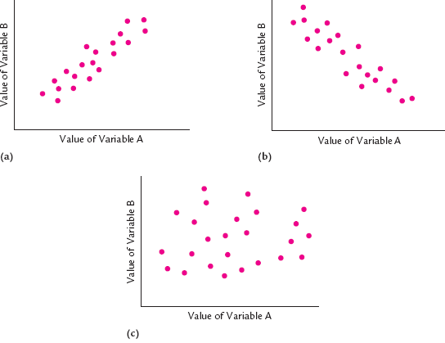
Correlation
Positive correlation -
- Negative Correlation
No correlation -

Slide 32
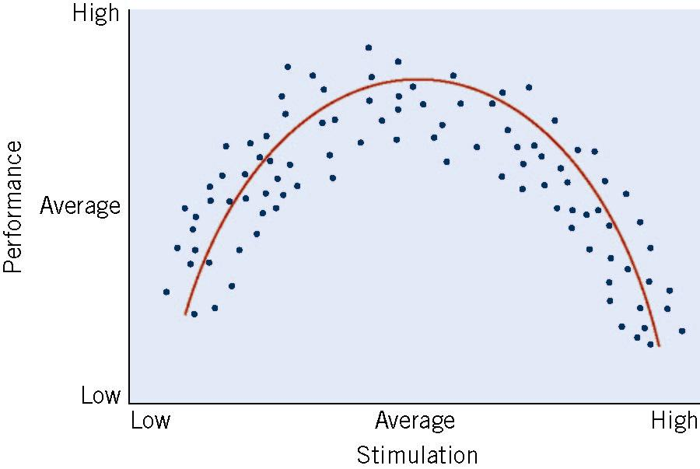
Curvilinear Correlation
Yerkes – Dodson arousal study
To low simulation = low performance
Moderate/ average simulation = high performance
High simulation = low performance
Figure 2.7
An Example of
a Curvilinear
Relationship

Slide 33
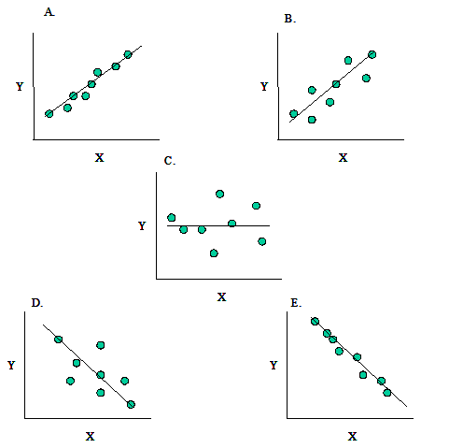
Regression
Regression
Line of “best fit”
Used for prediction of a criterion (DV) from a predictor (IV)
Multiple Regression
Allows for many predictors simultaneously
A – positive correlation good data
B – positive correlation okay data
C- no correlation
D – negative correlation bad data
E – negative correlation good data

Slide 34
Meta-Analysis
Aggregation of multiple studies of the same underlying relationship
Example: Job Performance vs. Job Satisfaction
N of studies | N of people | Estimated ρ
312 | 54,471 | .30

Slide 35
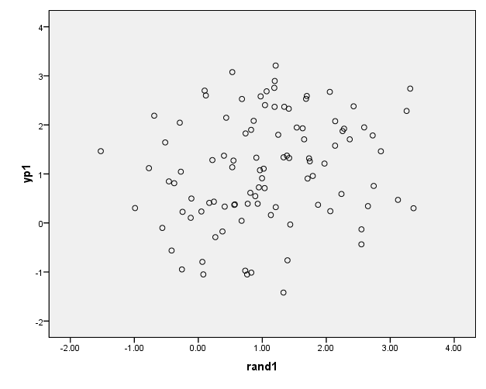
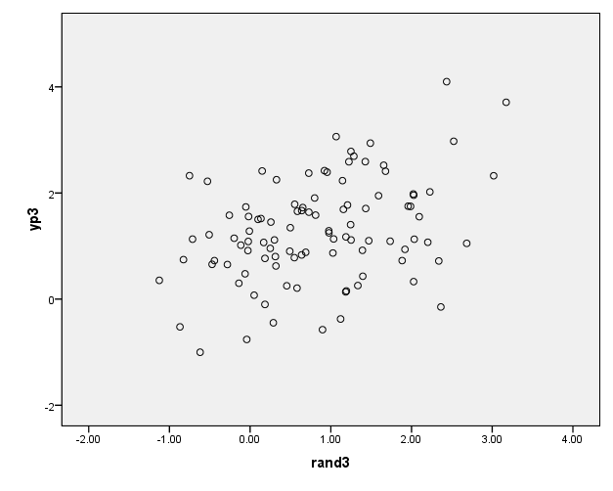
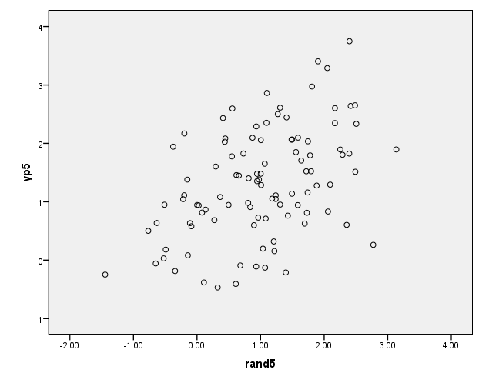
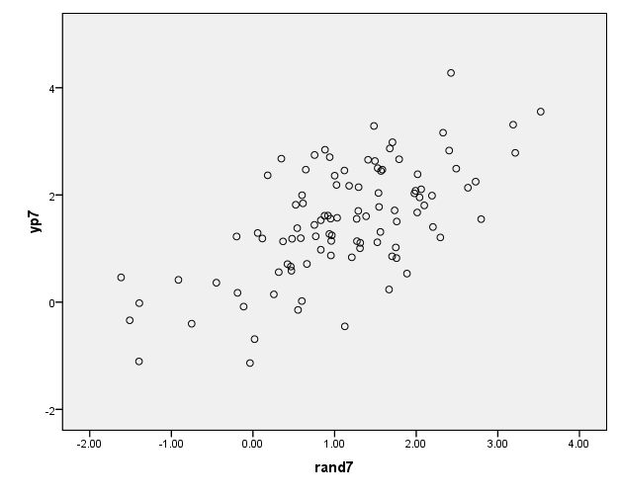
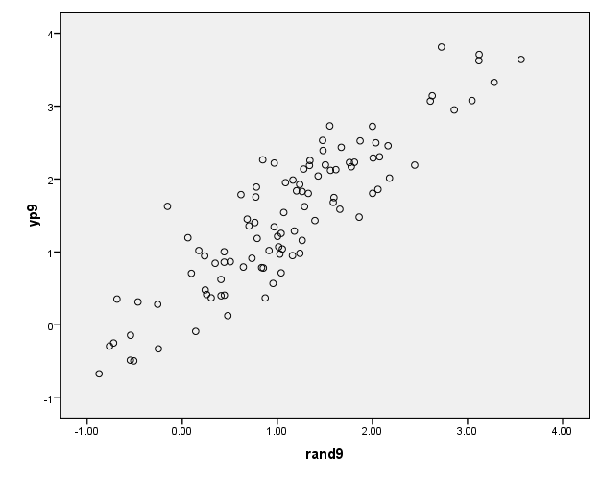
What is the relationship between Job Performance and Job Satisfaction?
r = 0.10
r = 0.30
r = 0.50
r = 0.70
r = 0.90

Slide 36
Module 2.4 – Interpretation

Slide 37
Reliability
The RELIABILITY of a Measure
A reliable measure produces similar results when repeated measurements are made under identical conditions
Reliability is necessary but not sufficient for validity
Should be > .70 (really want it greater to .8 – closer to 1 = happier)

Slide 38
Types of Reliability
Test – retest reliability: Administer the same test twice, hope for similar scores
Parallel – forms reliability: Alternate forms of the same test used; 12 versions of the same test then correlate the scores and want high correlations between them
Split – half reliability: Parallel forms are included on one test and later separated for comparison
Internal Consistency or Cranach's alpha: Average of all possible split-half reliabilities. Assesses how the items “hang together” – want them to correlate moderately

Slide 39
Validity
Validity of a study is distinct from validity of a measure
Is a study internally and externally valid?
Does the measure I’ve chosen actually measure what I want it too
Is my measure valid not is my study valid
The VALIDITY of a Measure
A valid measure measures what you intend it to measure
All measures asses the same thing- they all establish evidence for the validity of my measure
Validity is a unitary construct

Slide 40
Methods of Establishing Validity
Content validity: How adequately does a test sample behavior it is intended to measure?
A measure has content validity if its items are relevant to construct being measured
Do my items map on to the definition of my construct

Slide 41
Methods of Establishing Validity
Criterion – related validity: How adequately does a test score match some criterion score? Takes two forms
We pick based on resources available
Concurrent validity: Does test score correlate highly with score from a measure with known validity?
Test and criterion measured at the same time
Do scores correlate
do both things at same time
Predictive validity: Does test predict behavior known to be associated with the behavior being measured?
Time lag between test and criterion measurement
Does test predict criterion
Give a score then later measure performance/ sees if predictor actually predicts future behavior

Slide 42
Methods of Establishing Validity
Construct Validity: Do the results of a test correlate with what is theoretically known about the construct being evaluated?
Convergent validity: does the measure correlate with other theoretically similar measures
Discriminant validity: does the measure NOT correlate with other measures it theoretically should NOT be related to

Slide 43
Reliability vs. Validity
A game of darts as metaphor for a test. The goal of darts is to hit the bullseye.
Not consistent or accurate
Consistent but not accurate
Consistent and accurate

Slide 44
Relationships Between Variables
Direct (Causation)
Mediation
Moderation

Slide 45
Relationships Between Variables
CAUSATION -
Stress
JP

Slide 46
Relationships Between Variables
MEDIATION – mediation is the reason why x is related to y
ex) more stress = less job satisfaction = bad job performance
Stress (x)
Job Satisfaction (m)
JP (y)

Slide 47
Relationships Between Variables
MODERATION - variable that affects the direction and/or strength of the relationship between an independent
Job Satisfaction (m)
Stress(x)
JP (y)

